Slide 1

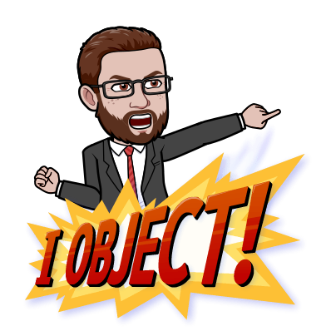
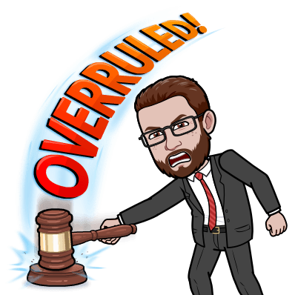
Mock Trials

Slide 2
Case 2: STATE v. JACKSON
Question: Did Terry Jackson drive in a reckless and negligent way, resulting in the death of Jane Anderson?
Crime: Negligent Homicide
To find the defendant guilty of negligent homicide, the prosecution must prove that:
Terry behaved in reckless way, putting others at risk.
Terry failed to realize that his actions were dangerous and could have resulted in someone’s death.
Terry is guilty of this crime beyond any reasonable doubt.

Slide 3
Case 2: STATE v. JACKSON
Prosecution:
Lawyer(s): Julissa
Chris Jones: Luciano
Pat Martin: Armani
Officer Kelly Demlong: Adilen
Researchers: Christian, Glenia, Sherlyn
Defense:
Lawyer(s): Jordan
Terry Jackson (Defendant) : Brian
Shaun Anderson: Trenton
Tracy Roller: Amanda
Researchers: Isabella, Elizabeth

Slide 4
VERDICT
By a vote of 5-2, we the jury find the defendant, Terry Jackson…
… of negligent homicide.
GUILTY!!!

Slide 5
Mock Trial Impressions
Preparation is paramount!
Clear speaking and organization are also important!
Having a good argument with evidence to support it is the key to a strong case.
Little details are sometimes the difference between a winning and losing case.
Cross-examination questions are crucial, but hard to prepare for.
Closing statements should leave a lasting impression in the mind of the jury.

Slide 6
Bell Ringer: Meme Generator
Think about what we’ve learned during the mock trial process about court cases, law, the role of lawyers and the jury, or even the mock trial process itself.
Go to the online meme generator at https://imgflip.com/memetemplates and create a meme about this!
Post your meme on our “Maps and Images” channel on Teams, with a one sentence explanation for it.

Slide 7
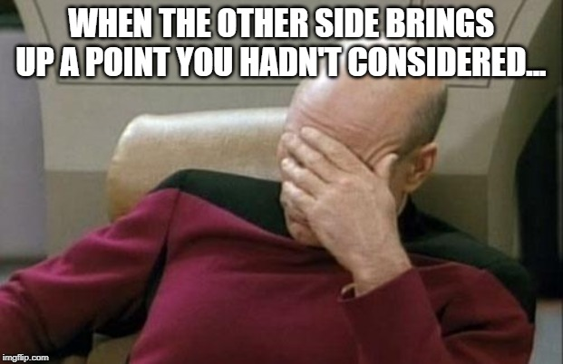
Bell Ringer: Meme Generator

